Slide 1
Design and Analysis of Algorithms
Sorting in linear time (Ch8)

Slide 2
Design and Analysis of Algorithms
Sorting in linear time
Topics:
Lower bound for sorting
Counting sort
Radix sort
Bucket sort

Slide 3
How fast can we sort?
All the sorting algorithms we have seen so far are comparison sorts: only use comparisons to determine the relative order of elements.
--E.g., insertion sort, merge sort, quicksort, heapsort.
--The best worst-case running time that we’ve seen for comparison sorting is O(n lgn).
Q: Is O(n lgn) the best we can do?
A: Yes, as long as we use comparison sorts
TODAY: Prove any comparison sort has Ω(n lgn) worst case running time.

Slide 4
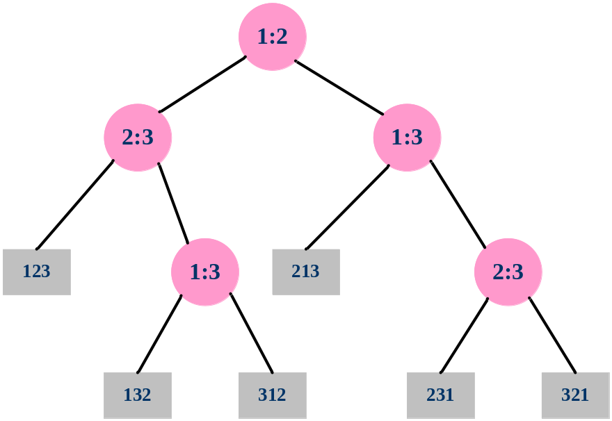
Decision-tree example
Sort <a₁,a₂,…,a_{n}>
Each internal node is labelled i:j for i,j∈{1,2,…,n}
--The left subtree shows subsequent comparisons if a_{i}≤a_{j}
--The right subtree show subsequent comparisons if a_{i}>a_{j}

Slide 5
Decision-tree example
Sort <a₁,a₂, a₃>=<9,4,6>
Each internal node is labelled i:j for i,j∈{1,2,…,n}
--The left subtree shows subsequent comparisons if a_{i}≤a_{j}
--The right subtree show subsequent comparisons if a_{i}>a_{j}

Slide 6
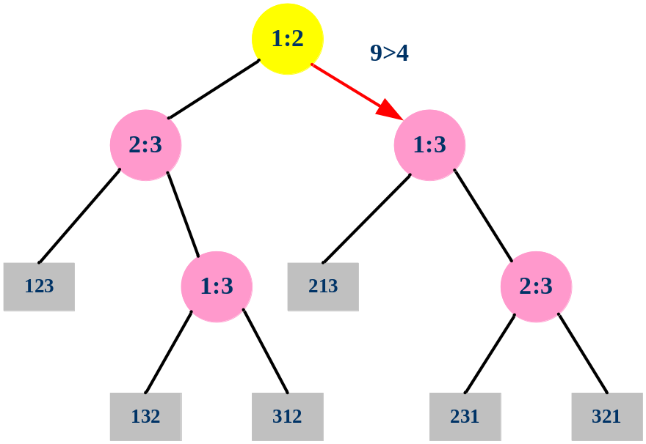
Decision-tree example
Sort <a₁,a₂, a₃>=<9,4,6>
Each internal node is labelled i:j for i,j∈{1,2,…,n}
--The left subtree shows subsequent comparisons if a_{i}≤a_{j}
--The right subtree show subsequent comparisons if a_{i} > a_{j}

Slide 7
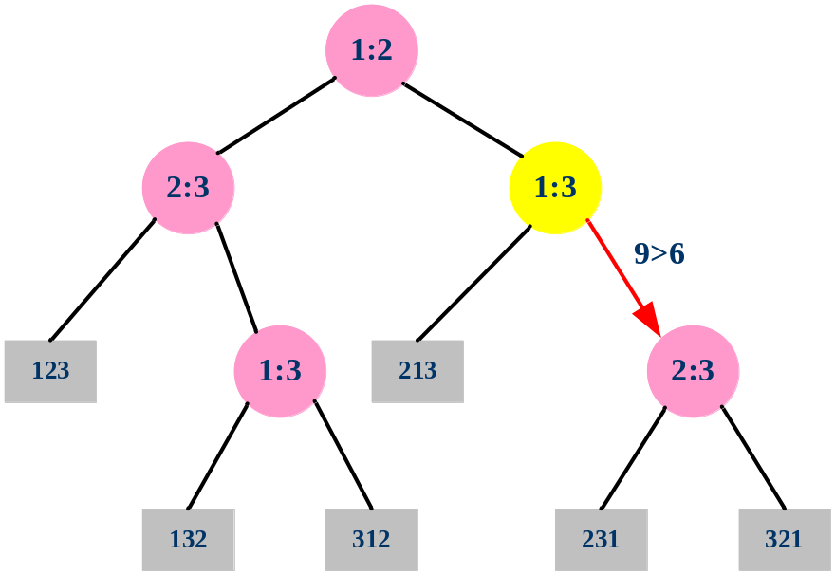
Decision-tree example
Sort <a₁,a₂, a₃>=<9,4,6>
Each internal node is labelled i:j for i,j∈{1,2,…,n}
--The left subtree shows subsequent comparisons if a_{i}≤a_{j}
--The right subtree show subsequent comparisons if a_{i}>a_{j}

Slide 8
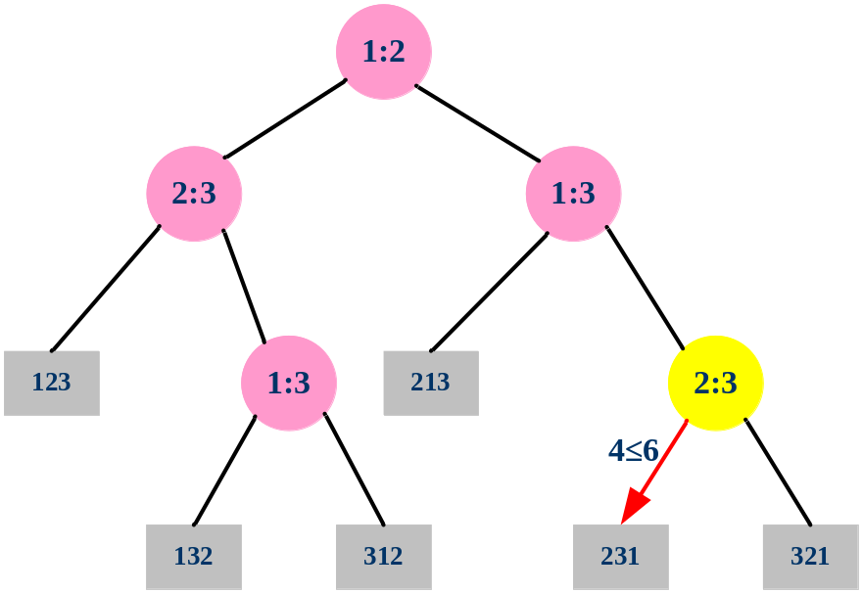
Decision-tree example
Sort <a₁,a₂, a₃>=<9,4,6>
Each internal node is labelled i:j for i,j∈{1,2,…,n}
--The left subtree shows subsequent comparisons if a_{i}≤a_{j}
--The right subtree show subsequent comparisons if a_{i}>a_{j}

Slide 9
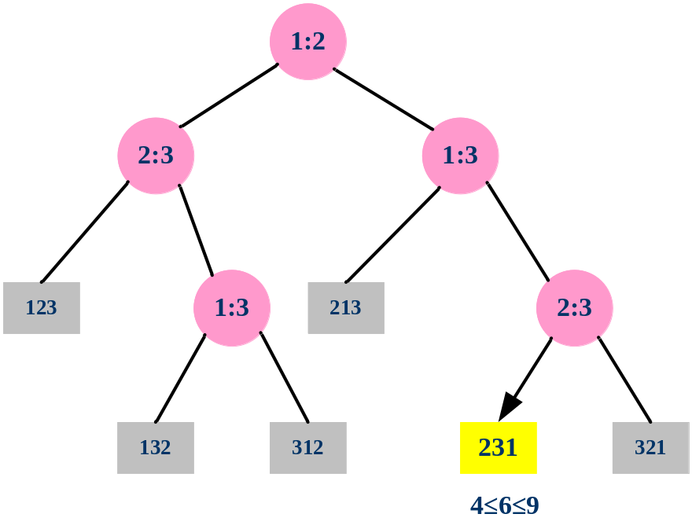
A decision tree can model the execution of any comparison sort:
--One tree for each input size n.
--View the algorithm as splitting whenever it compares two elements.
-- The tree contains the comparisons along all possible instruction traces.
--The running time of the algorithm = the length of the path taken.
-- Worst-case running time = height of tree.
Decision-tree example
Sort <a₁,a₂, a₃>=<9,4,6>
Each leaf contains a permutation <π(1), π(2),…, π(n)>to indicate that the ordering a_{π(1)}≤ a_{π(2)}≤…≤ a_{π(n)} has been established.

Slide 10
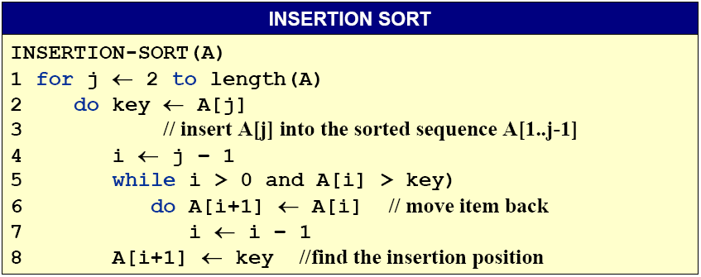
Any comparison sort
Can be turned into a Decision tree

Slide 11
Lower Bound for decision-tree Sorting
Theorem. Any comparison sorting algorithm requires Ω(n lgn) comparisons in the worst case
Proof. Worst case dictated by tree height h.
--n! different orderings.
--One (or more) leaves corresponding to each ordering.
--Binary tree with n! leaves must have height
lg is mono. increasing
∴ h ≥ lg (n!)
≥ lg (n/e)^{n}
= n lg n - n lg e
=Ω(n lg n)
Stirling’s formula
Notes:
Dictate:口述, 口授, 使听写, 指令, 指示, 命令, 规定

Slide 12
Lower Bound for Comparison Sorting
Corollary. Heapsort and merge sort are asymptotically optimal comparison sorting algorithms.
Notes:
Corollary：必然的结果, 系, 推论

Slide 13
Sorting Lower bound
Is there a faster algorithm?
If different model of computation?

